Slide 1
Impulse Excitation Technique
Cost Savings Example
Replacing Cold Crushing Strength Testing of Magnesite Brick with Impulse Excitation by Paul Bosomworth President/CEO BuzzMac International, LLC
Contact Info
Email: paul@buzzmac.com
Ph: +1 (603) 835-3180

Slide 2
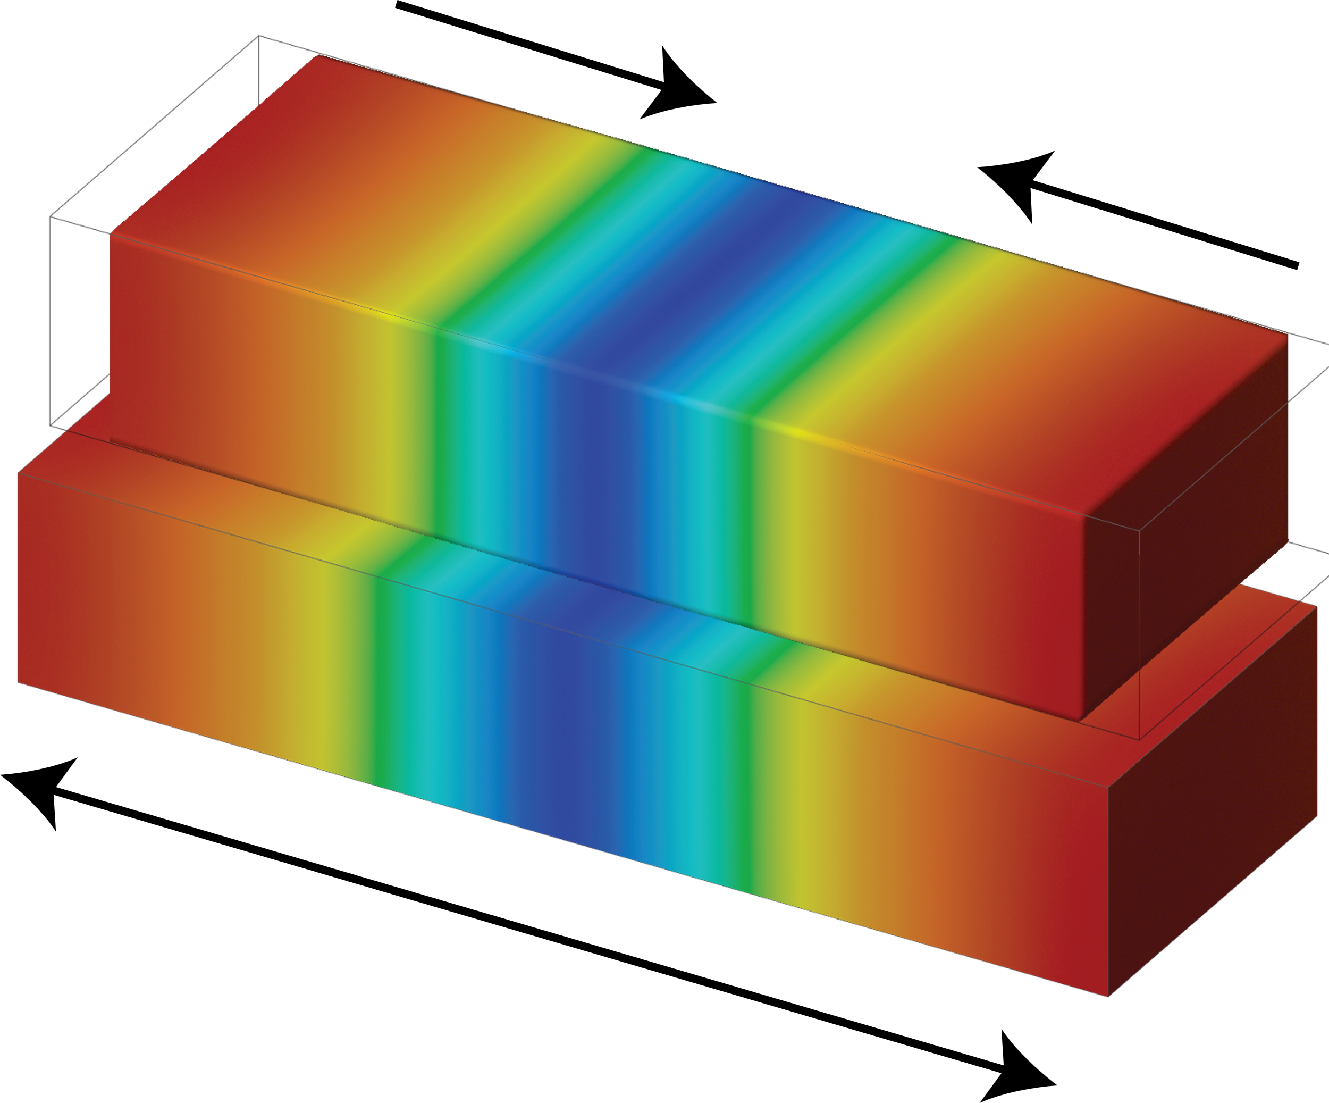
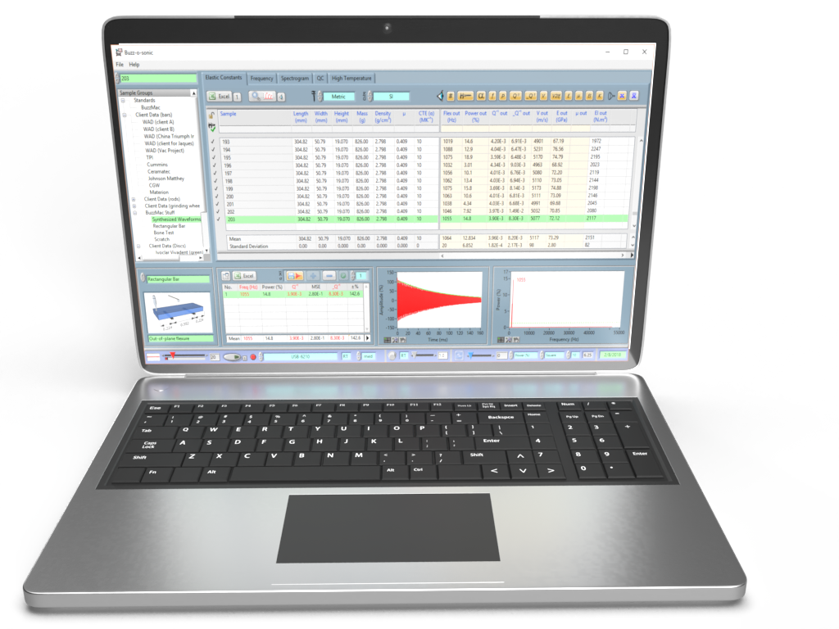
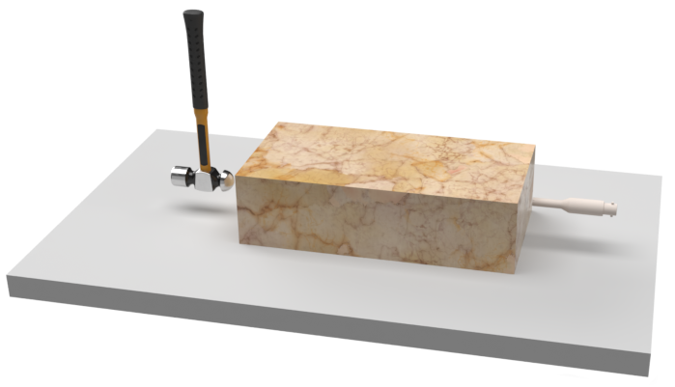
Impulse Excitation Technique (IET)*
TAP BRICK
MEASURE
VIBRATIONS
RECORD & ANALYSE
(damping/elastic properties)
Longitudinal mode of vibration
*also known as ping test, resonant vibration, impact acoustic resonance, eigen frequency method…

Slide 3
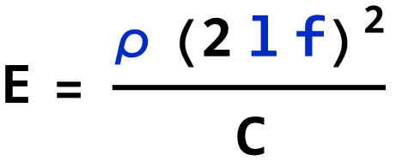
Impulse Excitation Test: Sonic Velocity
Impulse excitation is most often used to measure the Young’s modulus, shear modulus, Poisson’s ratio and internal friction of elastic materials. However, the Young’s modulus requires the measurement of the sample’s bulk density and all its dimensions (eqn. 1)., which can slow down the test. A much better method for rapid testing is to measure the speed of sound or sonic velocity, because this requires only the measurement of sample length and longitudinal frequency (eqn. 2).
…..1
v = 2 l f …..2
The sonic velocity given by eqn. 2 is technically the “rod velocity” which is the speed of sound for the actual brick and ignores a minor correction for shape (C in eqn. 1). However, eqn. 2 is acceptable for relative comparisons of sonic velocities.
Where:
E = Young’s modulus
l = length
f = longitudinal frequency
C = correction factor for finite sample size
and is a function of Poisson’s ratio
and sample dimensions
Where:
v = sonic velocity
l = length
f = longitudinal frequency

Slide 4
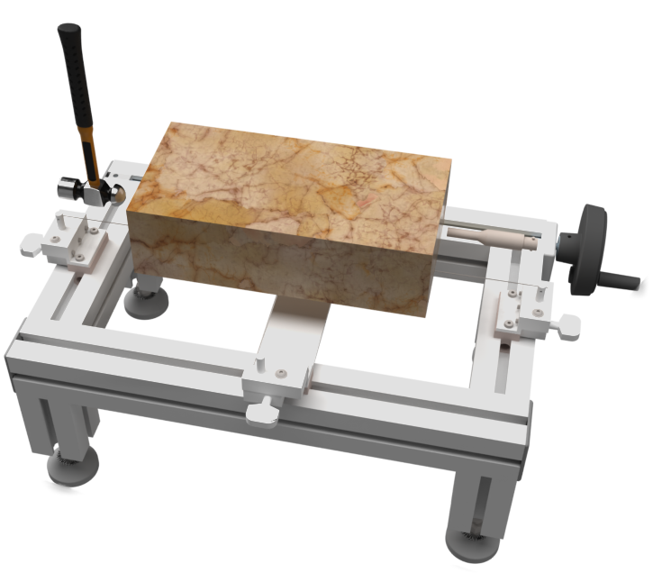
Experimental
Therefore, the magnesite brick were tested in the longitudinal mode of vibration.
Ideal support system
Magnesite brick supported on thin, crossed wires as per ASTM E1876 and C1259. One wire goes across the mid-length of the brick on the node for the fundamental longitudinal node of vibration. The other wire goes along the mid-width because the sample cannot balance on one thin wire. A better solution is to use two closely spaced wires or thin foam strip (~3/8” or 10 mm) placed across the mid-length. This reduces external damping.
Practical support system
Magnesite brick supported on a thin sheet of polyurethane foam. This is much quicker and easier to implement on the production floor. External damping is increased, but the effects on the fundamental longitudinal resonant frequency is negligible.
THIS METHOD WAS USED HERE

Slide 5
Results
A series of magnesite brick were tested¹ using impulse excitation and then cold crushing strength (fig 1).
Low strength population that we want to identify
¹ Paul A. Bosomworth and Pierre-Alexis Anctil, "Using IET to Reduce Production Costs," Ceramic Industry, 10-11 (November 2009)

Slide 6
Conclusions
Impulse excitation is much more rapid to implement than cold crushing strength.
Impulse excitation can be used to easily identify low strength brick.
Impulse excitation is nondestructive. Samples can be reused: another cost saving!

Slide 7
Conclusions and Comments
IET is ideally suited to measuring the sonic velocity and strength of refractories
IET can be used over a variety of testing environments (high/low temperatures, humidity…)
IET is fast, efficient and relatively low cost compared to destructive mechanical testing
IET is suited to R&D, QC/QA, cost reduction…
Any question or comments, please contact me on linkedin.com/in/paul-bosomworth-78151514

